Slide 1
Strategic Tic Tac Toe
By X’s and O’s
Adam Smith, Jo Friend, Jacob Larsen
These slides are an expanded version of the demo slides explaining the game, issues, and what not

Slide 2
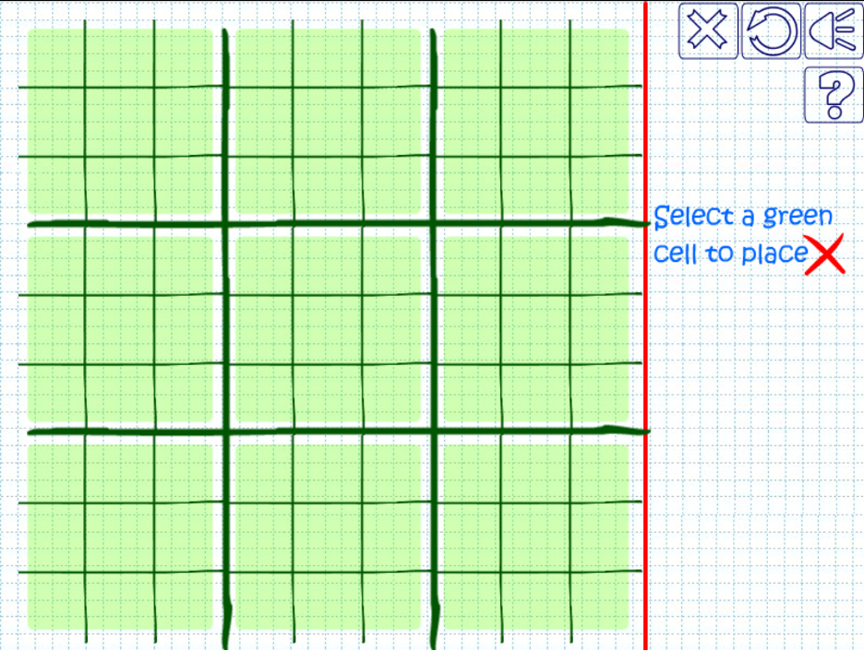
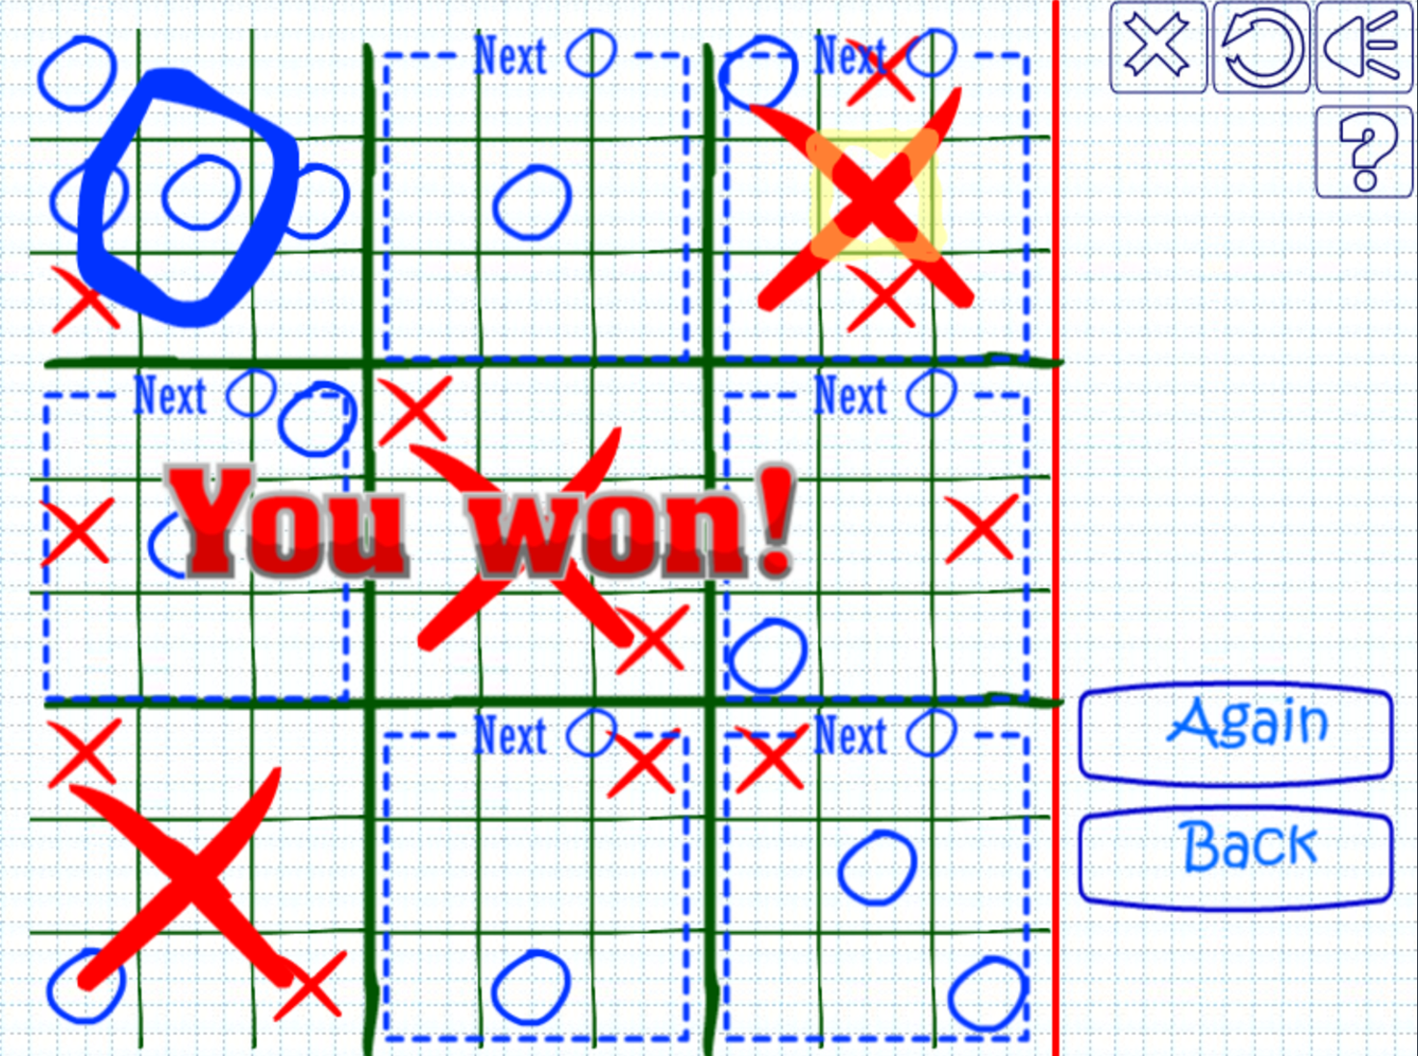
Overview of game
Notes:
Type of game (why), how it work, basic how to play

Slide 3
Current Implementation
Working Game
Two Player
Players are X and O. Game switches player after each turn
Basic Game menu
1-3 of available selections (Play new game, load, quit)
Basic Playing Menu
Selection of available squares are displayed to the user and you pick 1-9 out of the available squares for the board you are playing
‘S’ to Save, ‘Q’ to quit
Saving/Loading
Separate Color display

Slide 4
Future implementation(s)
Animations
At first we wanted animations for winning a board but time did not permit this
Multiple saves
Current there is only 1 save file in the future we want multiple as you may want to play the game with multiple friends
Single Player
Add an AI so you can play solo
How to play screen
Board highlights next square
When you’re choosing a square, the board you’re going to send your opponent to is highlighted
Display and Game integration
Currently the display and game are not integrated. In the future this would be done

Slide 5
What went well
Intuitiveness
Controls are easy to understand
Win conditions (kind of)
Due to the issue with ubuntu not working on a teammates computer (detailed later) the entire game function (checkGameOver) was not able to be thoroughly tested. As of now the function does not work as intended.
Simple controls
Jumping boards
The main feature of our game was successfully implemented
Save/Load with characters
This was due to the way traditional save/load function worked with objects. We believe they did not work with our code since we had other classes as some class’s variables.
Some integration
Basic visual was integrated but not entire display
Visual for menu
Simple and easy to understand

Slide 6
What didn’t
GameBoard -> TicTacBoard
This was our first instinct for polymorphism as these 2 classes share several attributes, however this proved difficult due to segmentation faults present when the Gameboard class had an array of TicTacBoards as a variable. This was deemed not possible since a parent has objects of its child inside of it.
Saving objects to file
As stated before traditional functions didn’t work with our classes so we just saved a whole bunch of characters
GitHub
GitHub did not update our files as others members worked on them. This caused the integration process to be very unpleasant, and keeping up with changes challenging.
Ubuntu
When one of our teammates computer stopped running ubuntu, that person could not test their program as they coded resulting a very slow coding process. This person had to send their code to be tested by another group member and that group member had to write a thorough test report as to what went wrong and when. This process some several function to work but not 100%. An example of this is the checkGameOver() which is a fundamental function for our game to work but due to the slow test cycle it was never thoroughly tested.
Remote testing (Ubuntu section)

Slide 7
Obstacles
Displaying
The display for the code was very hard to make. We found found a way to make a beautiful looking small ticTacBoard and blowing that code up to our level caused several issues. Integrating this code proved even more difficult.
Same code doing different things
At one point in time the display code was the exact same in two different programs. One program worked and the other didn’t. The cause of file that didn’t work was determined to be a corrupted file as both program were the exact same. This caused multiple headaches as this issue wasn’t thought of for some time.
Segmentation Fault
When doing polymorphism with the GameBoard -> TicTacBoard, we got segmentation faults. This was an issue because this was how we were going to demonstrate polymorphism. As a backup we planned to use polymorphism with the display class but after several failed attempts at integrating this also did not work. As such our code does use polymorphism. This problem can be traced back to the slow testing process that really bogged down out code production and caused us to not be able to focus on this requirement.
Where to use polymorphism (see above)
Ubuntu (not working on one team members device)
Collaboration (Github not properly syncing files)

Slide 8
Next Time
Test collaboration tool
As stated, GitHub did not fully work like we thought meaning that code production was slowed down. In the future, tediously looking at coding collaboration tools would be far more beneficial than just picking one.
Same page
Our team was building two minorly different games at one point. Normally this would be a quick fix but again the remote testing our team had to do caused normal delays to be much greater than normal
Early Start
We started this project very early however it was found that we ran out of time toward the end of the project, and couldn’t meet the polymorphism requirements of the project. Starting earlier would have given us time to meet this requirement
Working Ubuntu on all devices
We can’t say this enough, but this was a huge pain to work through and spending time in the beginning of the project to fix this would have been very beneficial.
Polymorphism
Our game had very little objects that had similar behavior. One of the key components were the gameboard and ticTacBoard as they shared similar functions, however due to the segmentation fault error, polymorphism was simply not possible. With such short notice we could not find a natural way to incorporate polymorphism as it was intended to be incorpated. While our group does understand where to use polymorphism our project turned out to be not an ideal project to demonstrate this knowledge

Slide 9
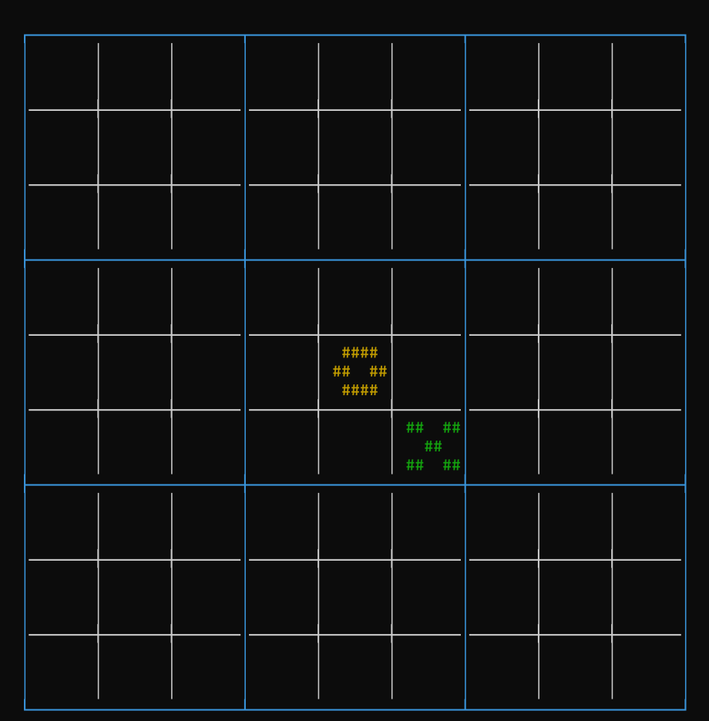
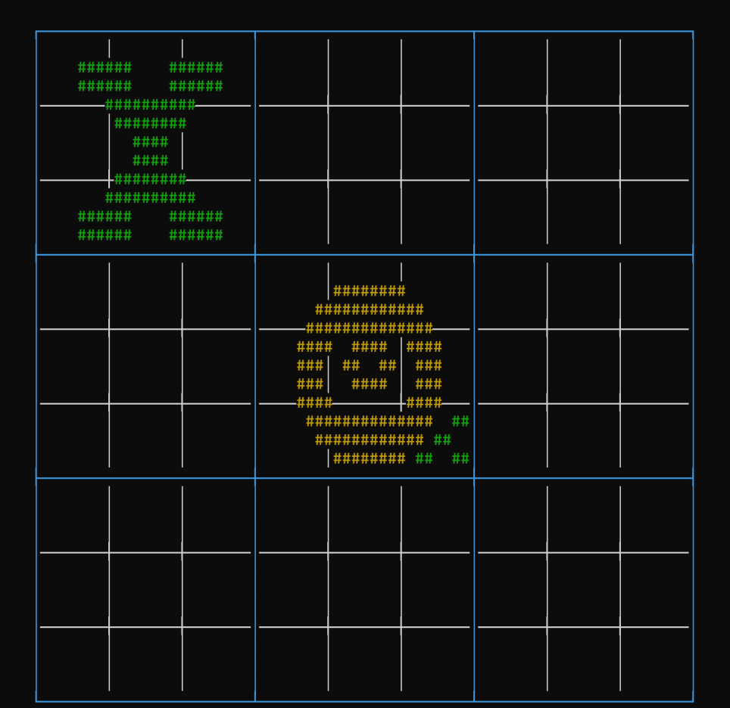
Our game demo

